Slide 1

GENERAL SERVICES ADMINISTRATION
Robotics Process Automation (RPA) & Intelligent Automation Track
October 12, 2018
Contents:
Robotics Process Automation (RPA) Implementation Lifecycle Panel
Build-a-Bot Workshop
Intelligent Automation Panel: Beyond RPA
Ed Burrows, GSA RPA Lead

Slide 2
Robotics Process Automation (RPA) & Intelligent Automation Track
Host for the RPA & Intelligent Automation Track:
Ed Burrows - GSA OCFO
Robotics Process Automation (RPA) Implementation Life Cycle Panel
10:00 AM - 10:50 AM
Moderator: Bob Grabowski - Deloitte
Panelists: Christopher Rose – Deloitte; Curtina Smith – OMB; Alicia Saucedo de Flores - GSA OCFO; Jia Jian (JJ) Shen – FDA; Christine Gex - Office of the Deputy Assistant Secretary of the Army (DASA)
Build-a-Bot Demos
11:00 AM - 11:50 AM
Workshop Leaders: Brian Diederich – Deloitte - Jim Walker - UiPath
Intelligent Automation Panel: Beyond RPA
12:00 PM - 1:00 PM
Moderator: Bob Dunmyer - Guidehouse
Panelists: William Carroll – Navy; Marina Fox – GSA; Mallesh Murugesan – Abeyon; CDR Thomas Sampson - Joint Strike Force;

Slide 3
Robotics Process Automation (RPA) Implementation Life Cycle Panel
10:00 AM - 10:50 AM
Key Outcome: The audience will understand OMB's guidance for shifting from low-value to high-value work and the steps and requirements for successfully implementing bots and running operations.
Description: This panel will begin with OMB's guidance on automation to move from low value to high-value work, and explain how to navigate the major phases of the RPA life cycle: candidate process assessment, IT platform and security, and ongoing operations management.
Moderator: Bob Grabowski - Deloitte
Panelists:
Christopher Rose - Deloitte
Alicia Saucedo de Flores - GSA OCFO
Jia Jian (JJ) Shen – FDA
Curtina Smith - OMB
Christine Gex - Office of the Deputy Assistant Secretary of the Army (DASA)

Slide 4
Robotics Process Automation (RPA) Implementation Lifecycle Panel
This panel will begin with OMB's guidance on automation to move from low value to high-value work, and explain how to navigate the major phases of the RPA life cycle: candidate process assessment, IT platform and security, and ongoing operations management.
Moderator
Bob Grabowski – Deloitte
Bob is a Senior Manager with Deloitte Consulting, supporting finance organizations across the Federal Government for over 16 years. He has extensive Robotic Process Automation (RPA) and Cognitive experience, delivering bots and automation across multiple departments and agencies. Most notably, he was the lead for Deloitte in supporting NASA with the deployment of process robotics – the first Federal Agency to deploy a bot in production. He also has extensive experience with Federal Financial Management and is a leader of digital transformations for CFOs and finance organizations.
Bob Grabowski
Deloitte
Panelist
Christopher Rose – Deloitte
Christopher is a Principal with Deloitte Consulting’s Strategy & Analytics practice specializing in the execution of complex strategy, enterprise cost reduction, and service delivery model transformation engagements. Chris currently practices in Robotic and Intelligent Automation offering for Deloitte’s Government and Public Services practice. Chris’ robotics and cognitive automation experience includes program strategy, client process and readiness assessments, and bot development/sustainment in the Federal Government, State Government, and Higher Education sectors.
Christopher Rose
Deloitte

Slide 5
Robotics Process Automation (RPA) Implementation Lifecycle Panel
This panel will begin with OMB's guidance on automation to move from low value to high-value work, and explain how to navigate the major phases of the RPA life cycle: candidate process assessment, IT platform and security, and ongoing operations management.
Alicia Saucedo de Flores – GSA OCFO
Alicia was named the Zone 1 Director of the OCFO’s Regional Financial Operations Division in 2015. In this role, she administers the comprehensive regional financial management program and advises senior regional officials on all PBS budget-related matters for Regions 1, 2, 3 & 5.
Alicia joined GSA in 1993 as an Financial Program Analyst and has served as an Asset Manager, Portfolio Financial Advisor, Revenue Manager, Budget Branch Chief and from 2011 till her Zone Director appointment she served as Director of the Budget and Financial Management Division in Region 5. Alicia also serves as a budget subject matter expert to several GSA national teams.
Alicia earned her Bachelor’s Degree in Finance from the University of Illinois at Chicago and her Master’s in Business Administration from DePaul University. She is also a graduate of GSA’s Advanced Leadership Development Program and a Senior Government Fellow.
Panelist
Alicia Saucedo de Flores
GSA OCFO
Panelist
Jia Jian “JJ” Shen – FDA
JJ has been with the FDA for over 4 years. He is currently a Project Management Officer with Office of Business Informatics where he manages service delivery for Integrity Service Master Data Management. JJ provides recommendations and facilitates the improvement of Master Data quality through a several initiatives within CDER.
Jia Jian “JJ” Shen
FDA

Slide 6
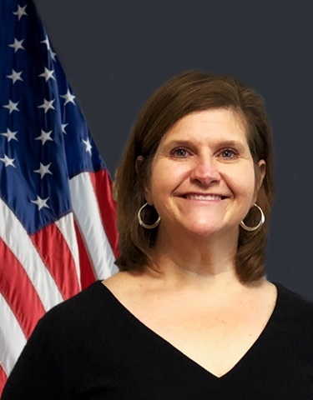
Robotics Process Automation (RPA) Implementation Lifecycle Panel
This panel will begin with OMB's guidance on automation to move from low value to high-value work, and explain how to navigate the major phases of the RPA life cycle: candidate process assessment, IT platform and security, and ongoing operations management.
Panelist
Curtina Smith – OMB
Curtina is a senior procurement policy analyst in the Office of Federal Procurement Policy (OFPP), Office of Management and Budget (OMB). Ms. Smith joined OFPP in January 2008 and has worked in areas such as: high risk oversight, interagency contracting, and program/project management. She holds a Bachelor of Arts degree in Business Management with a concentration in Economics and a Master of Science in National Resource Strategy.
Curtina Smith
OMB
Panelist
Christina Gex – Office of the Deputy Assistant Secretary of the Army (DASA)
Christine has been responsible for the development, deployment, and sustainment of two federal robotic process automation (RPA) programs. As the Chief Information Security Officer (CISO) at the NASA Shared Services Center (NSSC), she spearheaded the effort to issue credentials to robots; she was instrumental at NSSC in issuing common access cards (CACs) for robots to perform their work.
A leading innovator at DASA-FIM, she has been reaching across Department of Defense (DoD) organizations to expedite an infrastructure partnership allowing DASA-FIM to integrate their robots into customers’ daily workflows.
Ms. Gex holds a Master of Business Administration degree from William Carey University and is a Certified Authorization Professional (CAP).
Christina Gex
Office of the Deputy Assistant Secretary of the Army (DASA)

Slide 7
Build-a-Bot Demos
11:00 AM - 11:50 AM
Key Outcome: The audience will leave the session with a good feel for what bots are and how they are built.
Description: This session will demonstrate construction of two process robots and include audience participation!
Leaders:
Brian Diederich – Deloitte
Jim Walker - UiPath

Slide 8
Build-a-Bot Demos
This session will demonstrate construction of two process robots and include audience participation!
Leader
Brian Diederich – Deloitte
Brian currently serves as the lead developer for GSA OCFO RPA activities. In his current role, he developed the first automated process at GSA OCFO. In past efforts, Mr. Diederich has supported RPA efforts at multiple agencies including GSA, USDA, ICE, and HUD.
Brian Diederich
Deloitte
Jim Walker – UiPath
Jim is a former Army Artillery Officer and federal employee. He served at the Deputy Chief Information Officer and Services Portfolio Manager at the National Aeronautics and Space Administration’s Shared Services Center (NSSC). It was in this role as Services Portfolio Manager that he incubated new business for the NSSC. He designed and deployed the first RPA bot on a production system in the Federal government.
Currently, Walker is the global Director of Public Sector Marketing at UiPath focused on evangelizing RPA and other intelligent technologies across all levels of government. In addition to NASA’s RPA deployment he was responsible for bot deployments at the Treasury’s ARC and has assisted with 13 other agency deployments.
He is a member of the class of 2018 for Federal Computer Weekly “Federal 100”, and recognized as runner up at the Government Computer News “DigIT 2017” award for Robotics, Automation and Unmanned Systems.
Leader
Jim Walker
UiPath

Slide 9
Intelligent Automation Panel: Beyond RPA
12:00 PM - 1:00 PM
Key Outcome: The audience will gain an understanding of some important advanced automation tools. Those already using RPA will learn how data generated by bots can be used in intelligent applications.
Description: This panel will provide those involved with RPA exposure to advanced automation technologies such as machine learning, extraction of information from unstructured documents, neural network models, RPA generation of data sources for use by Artificial Intelligence applications.
Moderator:
Bob Dunmyer - Guidehouse
Panelists:
William Carroll - Navy
Marina Fox – GSA
Mallesh Murugesan – Abeyon
CDR Thomas Sampson - Joint Strike Force

Slide 10
Intelligent Automation Panel: Beyond RPA
This panel will provide those involved with RPA exposure to advanced automation technologies such as machine learning, extraction of information from unstructured documents, and neural network models.
Moderator
Bob Dunmyer – Guidehouse Bob is a Guidehouse Consulting leader focused on applying artificial intelligence and automation solutions to our client's most complex problems. He leads Guidehouse’s AI and Automation efforts supporting all sectors of the Federal Government. His team specializes in deploying AI and Automation solutions for fraud detection, supply chain optimization, and program evaluation using both RPA and machine learning techniques. Bob has more than 17 years of experience leading projects that use data discovery and advanced modeling techniques to separate the signal from the noise in both structured and unstructured data sets.
Bob Dunmyer
Guidehouse
Panelist
William Carroll – Navy
William works in the Engineering Directorate of the Military Sealift Command (MSC), he has worked in the engineering maintenance management branch for 20 years. He has training and experience in maintenance and reliability analysis as well as Information technology management. He has assisted with the development and implementation of the command’s maintenance management systems in support of the ashore maintenance management processes. He is the lead engineer for the implementation of RCM at the MSC. He is now working to establish maintenance data analysis tools and processes within the Military Sealift Command’s Engineering Directorate. One of his current projects is the implementation of Artificial Intelligence-based text analysis tool to assist with data reduction to facilitate more efficient data analysis by MSC Engineering support staff. William has a B.S. degree in Marine Engineering Systems from the U.S. Merchant Marine Academy.
William Carroll
Navy

Slide 11
Intelligent Automation Panel: Beyond RPA; cont.
This panel will provide those involved with RPA exposure to advanced automation technologies such as machine learning, extraction of information from unstructured documents, and neural network models.
Mariana Fox – GSA OCFO
Marina is a subject matter expert in the areas of data analysis, Business Intelligence (BI), enterprise reporting and KPI management. Her nearly twenty year tenure includes managing mid- to large scale business intelligence and analytics programs in the government and private sectors, from General Services Administration and USPTO to Deloitte, AOL, Booz Allen Hamilton, and The Wall Street Journal/Dow Jones & Co. In her previous role at GSA, she led a government-wide Digital Analytics Program (DAP), spanning across 5,000+ of .gov/.mil websites and supporting 2000+ agency customers as part of the President’s Digital Strategy. Marina is currently leading the .Gov Domain Services team at the Office of Government-wide Policy of GSA, providing a marketplace for secure connectivity, best practices and analytics to support .Gov domain customers.
Panelist
Mariana Fox
GSA OCFO
Panelist
Mallesh Murugesan – Abeyon
Mallesh is the Founder and CEO of Abeyon, is an innovative leader with 20+ years of experience in Technology and Design. He has been working with the Navy for 15 years in executing strategic IT initiatives and providing innovative technology solutions. His latest being Artificial Intelligence-based text analysis tool that recently won the Government Innovation Award.
Under his leadership, Abeyon has been working on several advanced AI technologies including Text Analysis, Category Management, NLP and more. His latest creation, chirrp.ai is a multi-channel chatbot platform that is powered by cognitive technology. And he has a patent pending on his intent identification methodology in a cognitive conversation.
Mallesh has a Masters in Information Systems from George Mason and an MBA from University of Maryland, College Park
Mallesh Murugesan
Abeyon

Slide 12
Intelligent Automation Panel: Beyond RPA; cont.
This panel will provide those involved with RPA exposure to advanced automation technologies such as machine learning, extraction of information from unstructured documents, and neural network models.
CDR Thomas Sampson – Joint Strike Force
CDR Sampson is a 1999 graduate of the State University of New York at Buffalo with a Bachelor of Arts in Political Science. He holds a Master of Information Technology Management and a Master of Business Administration, both from The American University in Washington, D.C.
Sampson enlisted and was designated a Naval Aircrewman serving as an Aviation Warfare Systems Operator on the P-3C Orion from 1999 to 2001. He deployed with Patrol Squadron One (VP-1) in support of western pacific (WESTPAC) operations and on his return, he selected for Officer Candidate School and was commissioned on 21 September 2001.
Sampson was designated a Naval Aviator at Naval Air Station (NAS) Whiting Field in May 2003. His flying assignment was with Helicopter Anti-Submarine Squadron Light Four Four (HSL-44) embarked in USS OSCAR AUSTIN (DDG 79) deploying in 2005 to support Operation Iraqi Freedom, and in 2006 conducting Anti-Piracy Operations off the Horn of Africa.
Sampson’s shore tour was on the Navy Staff, Air Warfare Division (OPNAV N88) as an Aviation Training Systems Requirements Officer and Program Manager Aviation Training Systems (PMA205) as an Integrated Product Team Lead for Common Simulation Products and Support.
Sampson affiliated with the Naval Reserve in May 2010 and his assignments include the Office of Naval Research / Navy Research Lab (ONR/NRL) as a Science and Technology Liaison Officer, Commander Submarine Forces Pacific as a Theater Anti-Submarine Warfare Watch Officer and Deputy Operational Planning Team Lead, and United States Fleet Forces Command Maritime Operations (MOC) as a Crisis Action Team MOC Watch Officer. He is currently on active duty and assigned to the F-35 Lightning II Joint Program Office as the Enterprise Data Strategy and Management Lead.
His awards include Navy Commendation Medal, Navy Achievement Medal, unit and service awards. He is certified as a Project Management Professional (PMP), and holds multiple Defense Acquisition Workforce certifications.
Panelist
CDR Thomas Sampson
Joint Strike Force

Slide 13
Host for the RPA & Intelligent Automation Track
This track provides practical guidance on the RPA project life cycle, from candidate process assessment to ongoing bot operations management. See how a bot is constructed and run! Learn about automation beyond RPA - Intelligent Automation, including a Navy project that won a Government Innovation Award!
Ed Burrows – GSA OCFO
Ed is a Senior Advisor at GSA leading Robotics Process Automation (RPA) for the Office of the Chief Financial Officer. He is also the liaison to the U.S. Department of Agriculture as the financial management shared service provider to GSA, leads GSA's 's implementation of Treasury's Invoice Processing Platform (IPP) and led the migration of GSA's child care subsidy administration programs to a commercial provider and the Department of Agriculture. Prior to joining GSA in 2015 Ed led financial operations and programs in the telecommunications industry, including senior leadership positions at MCI, Concert Communications, BT Group, and Telarix. Ed holds a B.A. degree in Economics from The Pennsylvania State University and a M.A. in Economics from University of Virginia.
Host
Ed Burrows
GSA OCFO

Slide 14

Process Robotics
A Digital solution to automating transactional work that empowers valuable labor and improves operational efficiency
October 2018

Slide 15
Process Robotics can transform back office and mission-focused transactional work to achieve cost savings and operational efficiencies
Process Robotics is a rules-based software application. It is quick and inexpensive to implement and sustain, and it does not require configuration of existing IT infrastructure.
Process robotics tools are programmed to perform repeatable tasks: programmed to replicate repetitive human tasks using recorders and easy programming language
Process robotics operates effectively in the U/I layer: able to automate rules-based work without compromising underlying IT infrastructure
Process robotics replicates human interactions with proven technology: mimics common tasks such as queries, emailing, merging information, and button clicks
Process robotics can be implemented at the desktop or in the virtual environment: flexibility to quickly deploy robots directly onto existing desktops or virtually to save on additional hardware costs
By mimicking human actions, process robotics can quickly enable organizations to
build a cost-effective, digitally-enabled workforce

Slide 16


The Process Robotics Roadmap guides your organization’s automation
A deliberate path starts with an assessment followed by a pilot project, and sets the stage for enterprise scalability.
The Process Robotics Roadmap…
Launch Solution / Build COE
Develop, test, and refine based on feedback from PoC / pilot
Build COE to govern capability
Operating Model Assessment
Ideation and prioritization
Domain prioritization
Process analysis
Business case development
Scale
Launch / Build COE
PoC / Pilot
Scale Across Enterprise
Identify resource requirements
Deploy solution at enterprise level, leveraging scalable infrastructure
OMA
PoC / Pilot the Minimal Viable Product (MVP)
Leverage OMA to accelerate build and reduce implementation risk
Architecture analysis
Training – people, process, and tech

Slide 17
Eight evaluation criteria can be used to identify strong process candidates
Criteria | Description | Sub-Criteria
Number of Systems Used | A process should typically require employees to access multiple independent systems to complete the process | List of Systems Used
 |  | Ease of Access / Integration
Transaction Volume | A process need not be limited to high-value transactional processes. Any process that is labor intensive, time-consuming, or has high-cost impact errors qualifies | Annual Volume
 |  | Subject to Spikes
Prone to Errors or Re-Work | Manual activities in the process today result in errors due to human operator mistakes (e.g. complexity of work or infrequency of activity) | Error Frequency
 |  | Error Impact
Process Predictability | A process needs to be defined in terms of a set of unambiguous business rules | Size of Decision Trees
 |  | Business Logic Complexity
 |  | Business Rule Documentation
Rules-Based Exception Handling | Simpler processes with little exceptions in delivery are excellent candidates in the beginning. With experience, there is potential to expand to processes that are more complex | Number of Exceptions
 |  | Business Rules for Exceptions
Manual Work Involved | A process should have little automation support today and large amounts of manual work | Number of Keystrokes
 |  | Number of FTEs
System Upgrade Timing | A process should be avoided if it interacts with a system scheduled for a major planned upgrade within 6 months. Major upgrades beyond minor enhancements need to be planned for in order to prevent rework | Date of Upgrade
 |  | System Importance to Workflow
 |  | Enhancement Scope
Controls Importance | A process that is high-risk or has sensitive data that requires strong oversight and set of internal controls | Process Risk Levels
 |  | Audit Data Requirements
 |  | Regulatory Demands

Slide 18

Panelists

Slide 19

GENERAL SERVICES ADMINISTRATION
Robotic Process Automation
Getting Started
October 12, 2018
Alicia Saucedo de Flores, OCFO Zone 1 Director

Slide 20

Getting Started
Identifying Projects –
Any high-volume, business rules driven, repeatable process
Processes with high error rates
Processes containing manual data entry
Processes dealing with multiple systems & associated screens
Repetitive and mindless processes
(Frequency of re-keying and collating data)
–Processes which are composed mainly of copy and paste of information from one system to another or data validation (comparing data from one application to another), benefit greatly from automation, as well as increase employee satisfaction since these processes are very clerical, time consuming, prone to errors, and not very fulfilling to do.

Slide 21
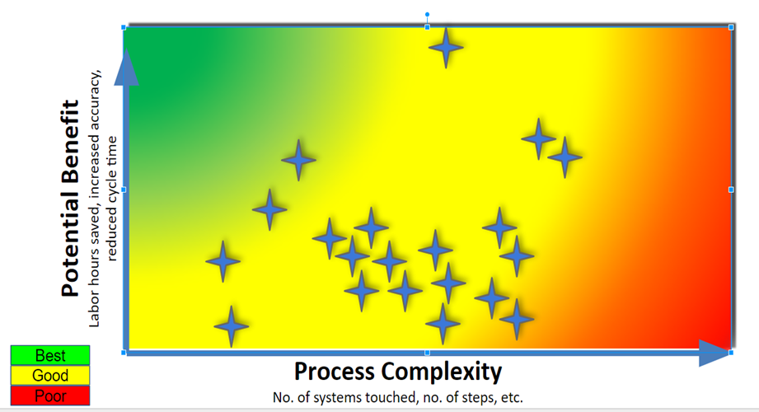
Getting Started
Project Selection

Slide 22
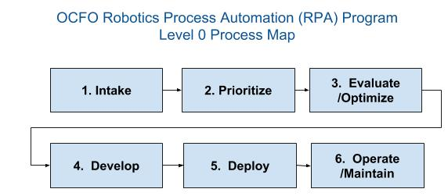
GSA OCFO RPA Program
Notes:
We have a six step process, while all of them are important, I’m going to talk about Steps 1-3 as these are the steps that I have been a part of...

Slide 23
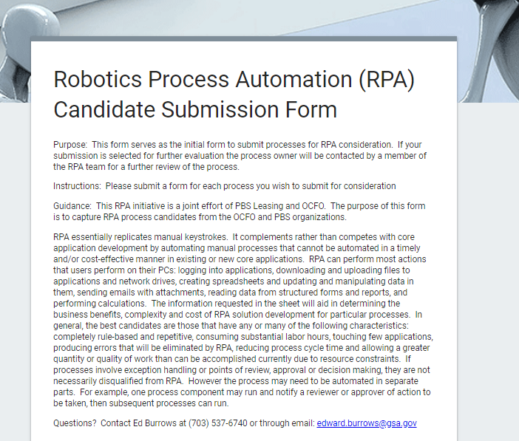
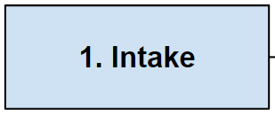
RPA Candidate Intake Process
Open intake process
Anyone in organization can submit a process for consideration
Using a web based Form (Google)
Initial screening conducted

Slide 24
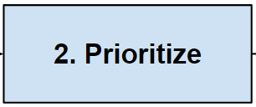
Prioritizing Candidates
OCFO Leadership Team reviews candidate processes
High level look at the following project attributes
Current process
Staff hours per month
# of Systems involved
Exception Handling
Error Frequency
Prioritizes based on strategic and benefit merits

Slide 25
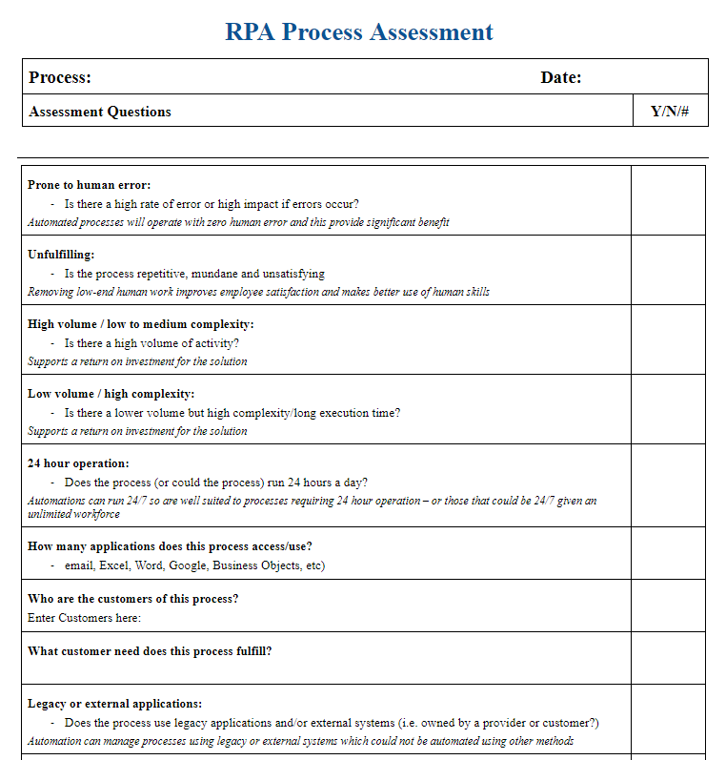
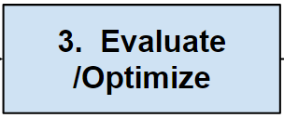
Evaluating & Optimizing

Slide 26

Food and Drug Administration (FDA)
The FDA’s Office of Business Informatics is building a new Robotics Process Automation (RPA) capability to automate part of the drug application intake process and assist in large-scale data quality remediation efforts. This improves the speed and accuracy of data entry, improves data quality, and helps reduce the total time of drug review.
Issue
Action
Impact
CDER receives thousands of applications for new original drugs (NDA), generics (ANDA), and biologics (BLA). FDA's legacy state included paying a team of nearly 20 full-time personnel to perform manual data entry of application PDFS into the reviewer system.
Declining top line budgets and pressure to improve the speed and accuracy of application review has led FDA to rethink this process.
Conducted Operating Model Assessment
Candidate Process Evaluation: Identified manual, high-transaction processes.
Process Robotics Vendor Analysis: Conducted an analysis of eight RPA vendors.
Proof of Concept and Implementation: Developed a prototype in a test environment similar to the client’s live system.
60%
Improvement in average processing time
Company Bot
8,000
Hours of manual work
saved
CDER maintains a large repository of sponsor-submitted data that is used during the regulatory review process for drugs. However, data discrepancies hinder the efficiency of the review process and impact agency performance against user fee commitments by delaying official correspondences, facility inspections or product quality reviews.
Developed data quality bots that locate, validate, cleanse, and compile large volumes of data related to company, product, and supply chain.
The information that the bots cleans and validate is handed off to Analysts to complete additional analysis. In some cases the Analysts hand the information back to the bots to write updates directly to the database
98%
Reduction in cycle time
Data Quality Bot
5,498
Hours of manual work
saved

Slide 27
Solicitation Review Tool (SRT)
October 2018
Presented By: Marina Fox, OGP
Notes:
Each deck must include a cover slide.

Slide 28
What is SRT?
What is Solicitation Review Tool (SRT)?
It is an automated predictive analysis application that performs scans of the Federal Business Opportunities /FedBizOpps website and delivers:
a report containing all of the new solicitations for the previous day,
a report of flagged solicitations that require manual review for specific regulatory requirements and compliance, and
a web-based portal for agency SMEs to perform manual reviews of flagged solicitations and to communicate with contracting POCs for improvement, and
analytics and trending of flagged solicitations overtime by agency and gov-wide
SRT uses natural language processing, text mining, and machine learning algorithms to automatically identify whether a solicitation contains sufficient compliance requirements for a particular use case (e.g. Section 508 Technical Requirements).
Notes:
Sample slide layout

Slide 29
SRT - Long-Term Goal
Long-term Goal - Automated Review of Solicitations for ANY specific contract requirements
Scan all of the solicitations on FedBizOpps for the presence of different requirements (e.g. cyber security)
Use a series of prediction algorithms and text data mining to generate a list of solicitations flagged for manual review
Present the flagged solicitations in the SRT web portal for manual review, communication with solicitation POCs and progress tracking.
Present usage analytics and progress/history trends of flagged solicitations (pre and post review)
Notes:
Sample slide layout

Slide 30
SRT - Short-Term Goal
Short-term Goal - Automated Review of Solicitations for Section 508 Requirements
Scan all of the EIT/ICT solicitations on FedBizOpps for the presence of Section 508 requirements
Use a series of prediction algorithms and text data mining to generate a list of EIT solicitations flagged for manual review by agency 508 coordinators due to missing 508 requirements
Present the flagged solicitations in the SRT web portal for manual review, communication with solicitation POCs and progress tracking.
Present usage analytics and progress/history trends of flagged solicitations (pre and post review)
Notes:
Sample slide layout

Slide 31
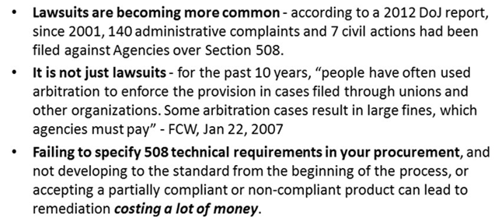
What’s the Big Deal?
Why is identifying EIT solicitations with missing Section 508 technical requirements so important?
Source: GSA, Section 508 Event at NSF, April 4, 2017
Notes:
Sample slide layout

Slide 32
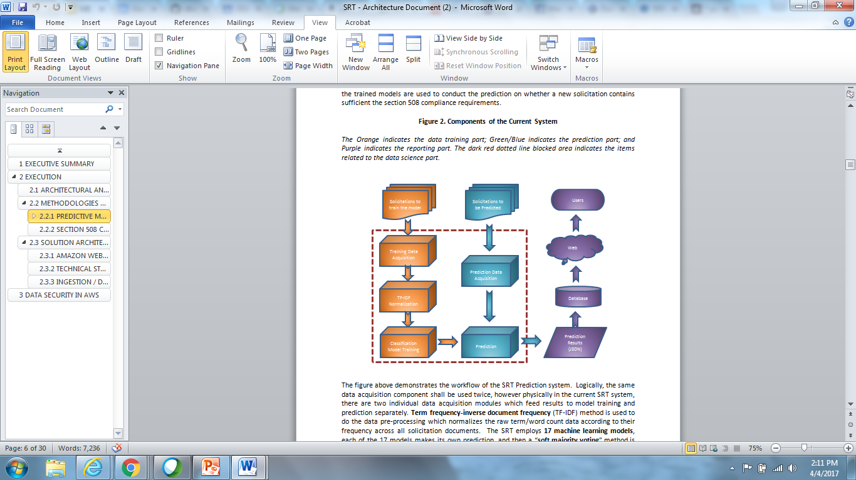
What’s Under the SRT Hood?
SRT has four major components in its prediction system: data acquisition, data pre-processing, classification model training, and prediction.
Classification models are trained by machine learning algorithms using training datasets, and trained models are used to conduct the prediction on whether a new solicitation contains sufficient the section 508 compliance requirements.
Notes:
Sample slide layout

Slide 33
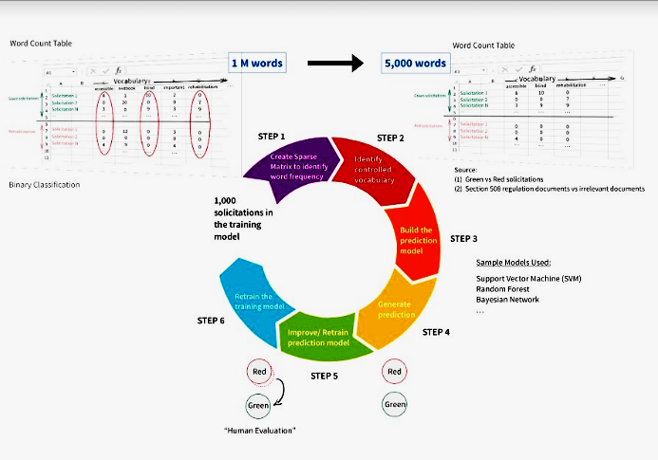
SRT - Data Science

Slide 34
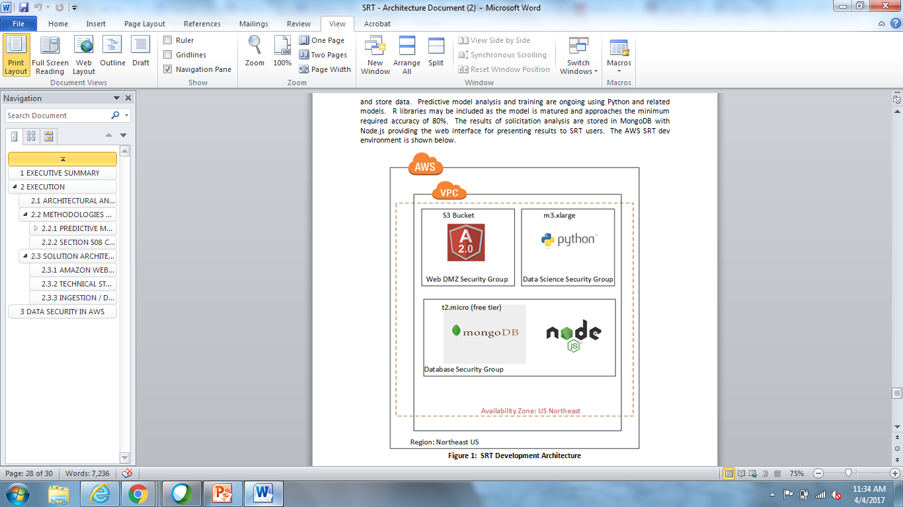
SRT - Architecture (Dev)
- Python - used for data parsing, ingestion. and big data model creation
- Node.js - application framework (Express) and for I/O operations (REST operations and MongoDB interface)
- MongoDB - a database for storing raw, cleansed solicitations data and prediction data
Notes:
The development environment is hosted by Amazon Web Service and consists of an S3 Bucket, to host the Angular Front end, and (2) servers, which will be increased based upon performance needs of the Python predictive model. The base set of (2) servers are utilized to ingest, process, and store data. Predictive model analysis and training are ongoing using Python and related models. R libraries may be included as the model is matured and approaches the minimum required accuracy of 80%. The results of solicitation analysis are stored in MongoDB with Node.js providing the web interface for presenting results to SRT users.

Slide 35
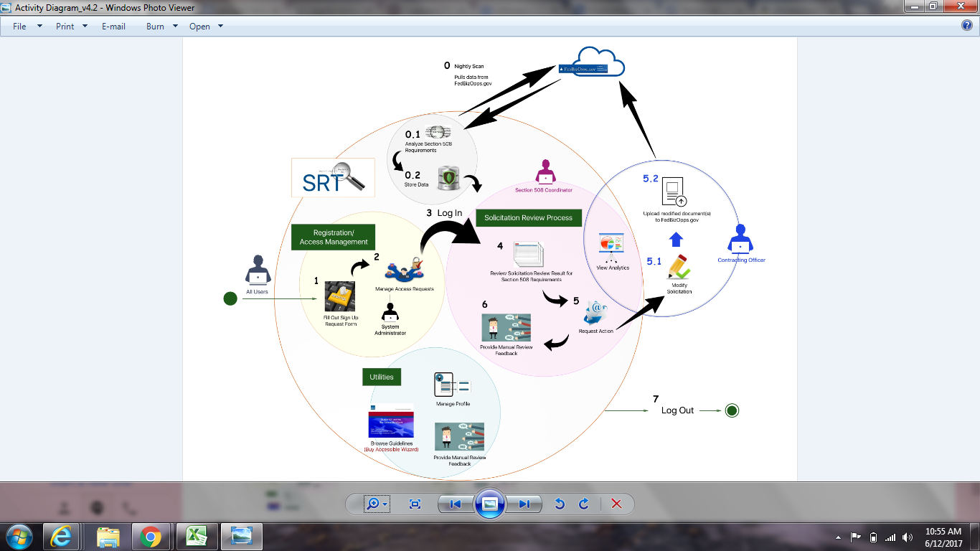
SRT Activity Diagram

Slide 36
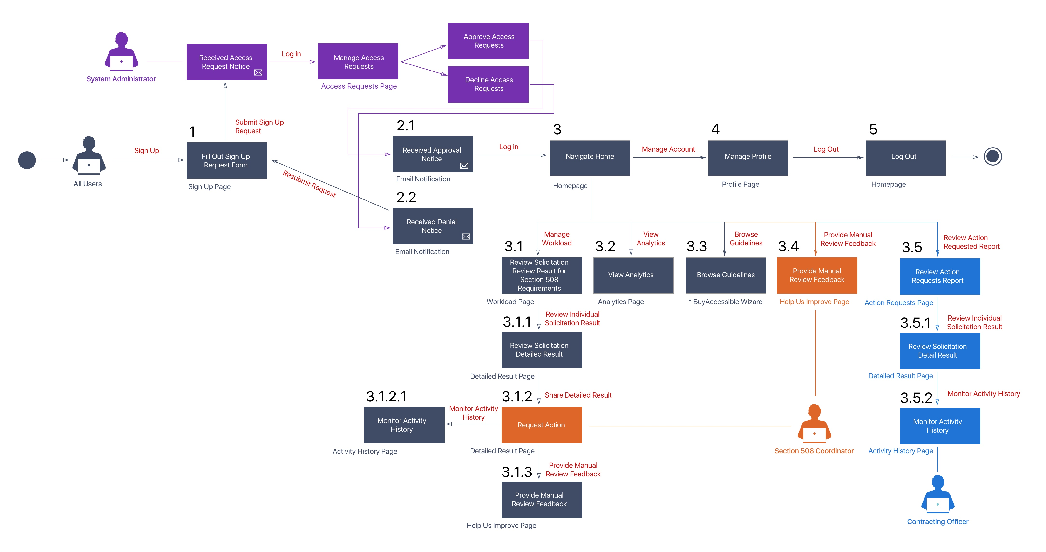
SRT Information Architecture

Slide 37
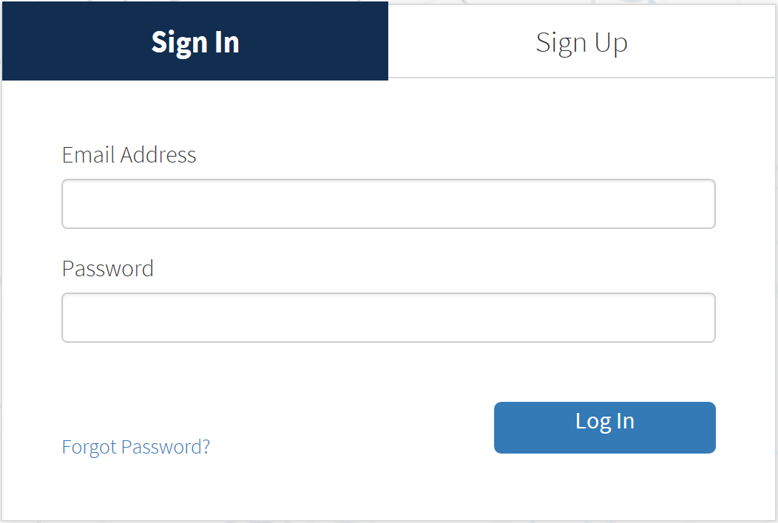
SRT Web Portal Sign In / Sign Up
Sign in using single factor authentication.
Or sign up for an account, which requires approval from the System Administrator.

Slide 38
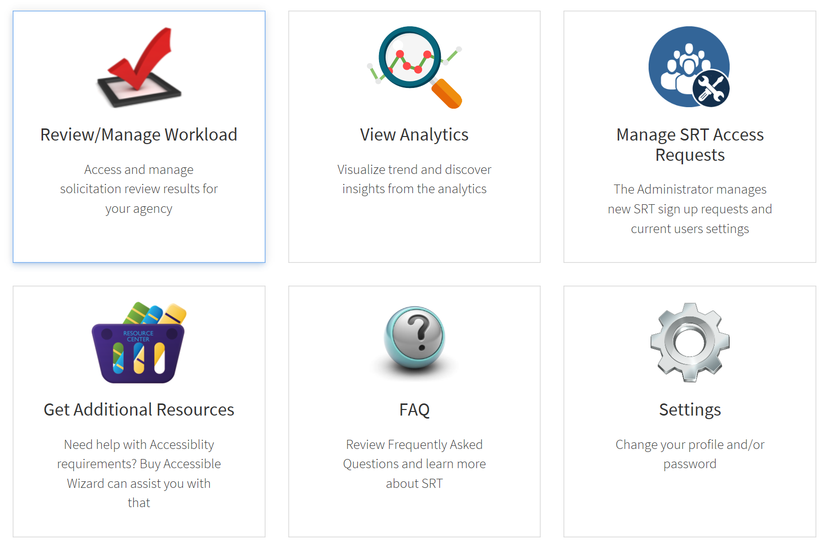
SRT Home Page
Users manage workload, views predictions of non-compliant solicitations, edits profile, and gets resources.
System Administrator approves and manages user accounts and access.

Slide 39
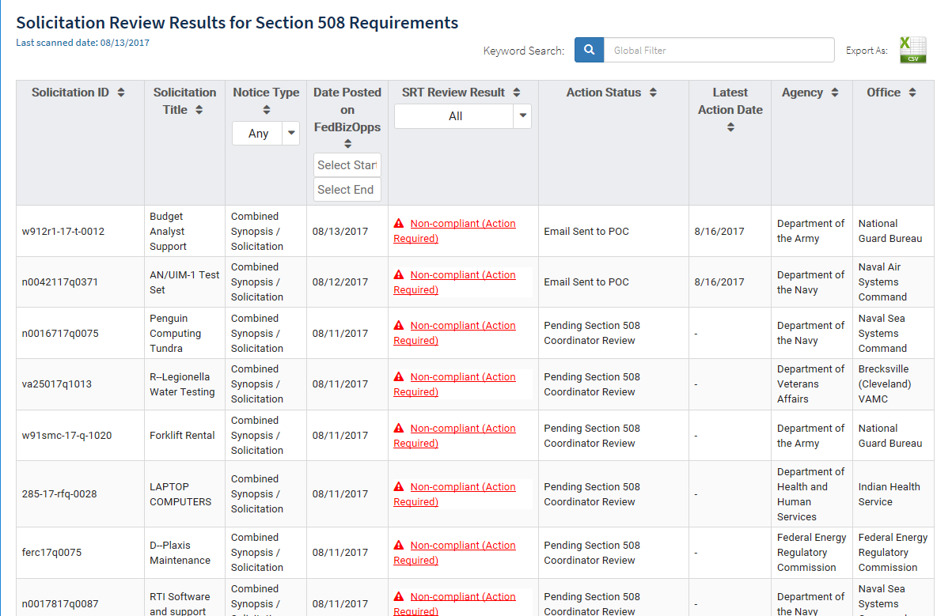
Review / Manage Workload Module
Reviewer manages ICT / E&IT solicitations that his/her agency posted on the FBO.gov website.
Reviewer inspects solicitations that the machine predict to be non-compliant.

Slide 40
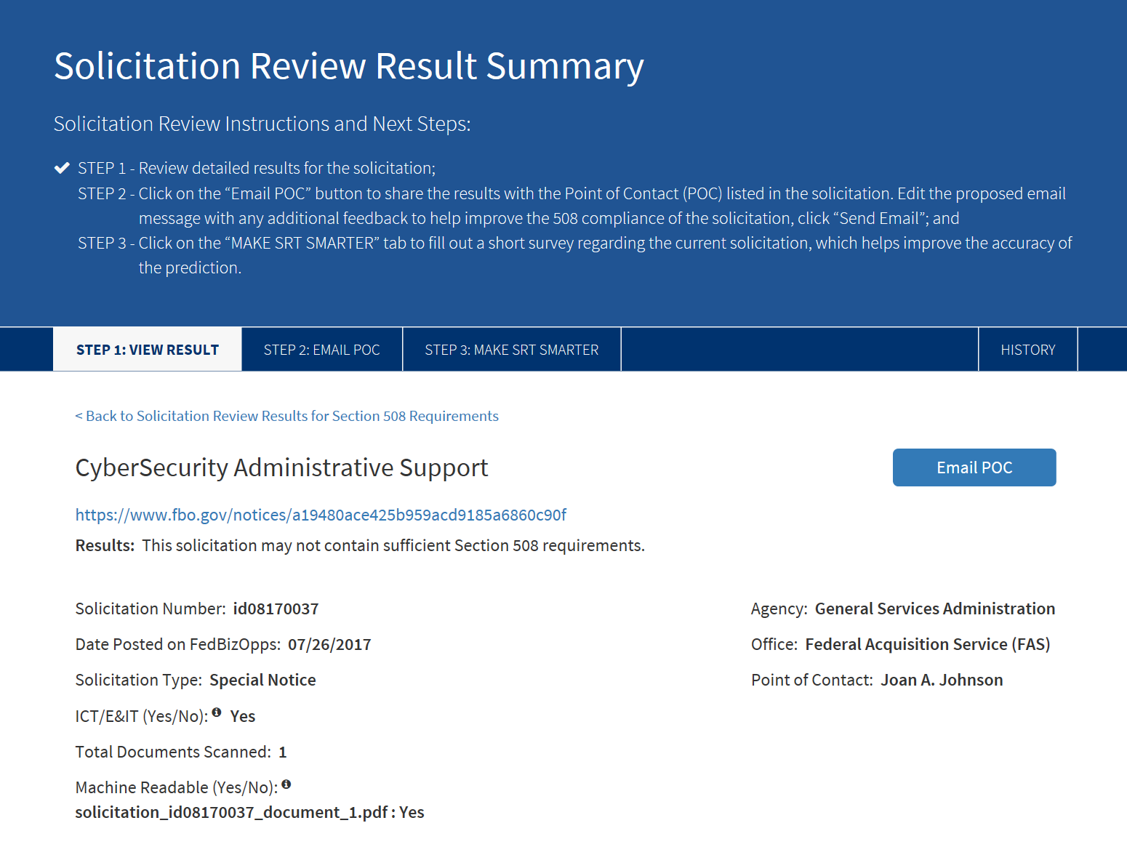
Review Solicitation – Step 1
Reviewer analyzes the detailed results of the selected solicitation to determine whether the prediction is accurate.

Slide 41
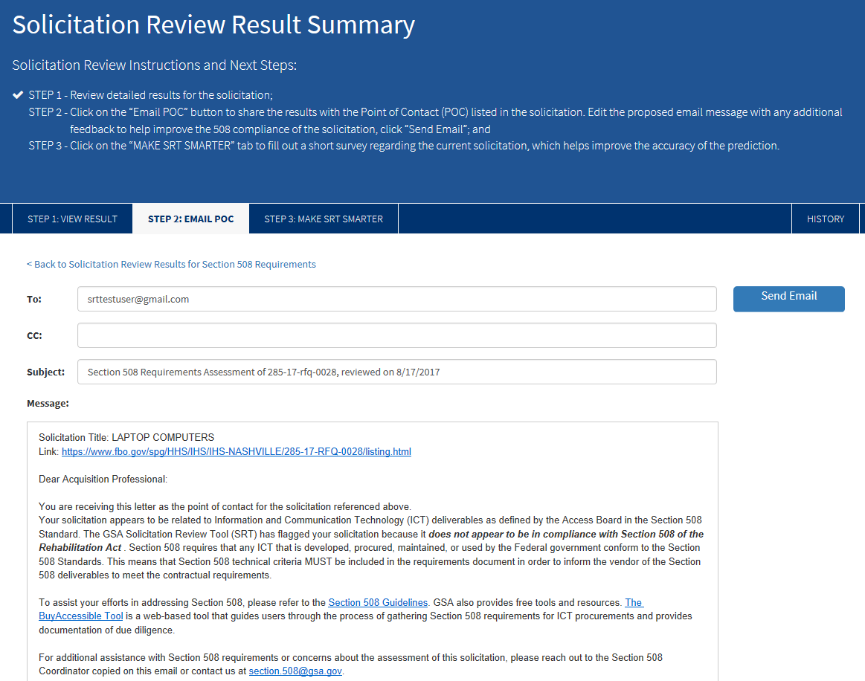
Review Solicitation – Step 2
Reviewer emails the Point of Contact (POC) to inform him/her that the solicitation is non-compliant.
Reviewer can edit the proposed email with any additional feedback to help improve the 508 compliance of the solicitation.

Slide 42
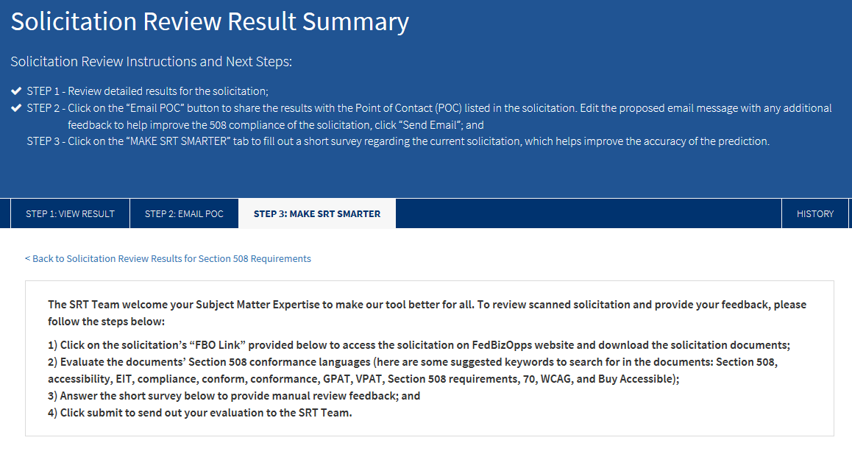
Review Solicitation – Step 3
Reviewers fill out a short survey to help make the machine learning algorithm smarter by telling it whether the prediction is correct.

Slide 43
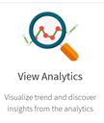
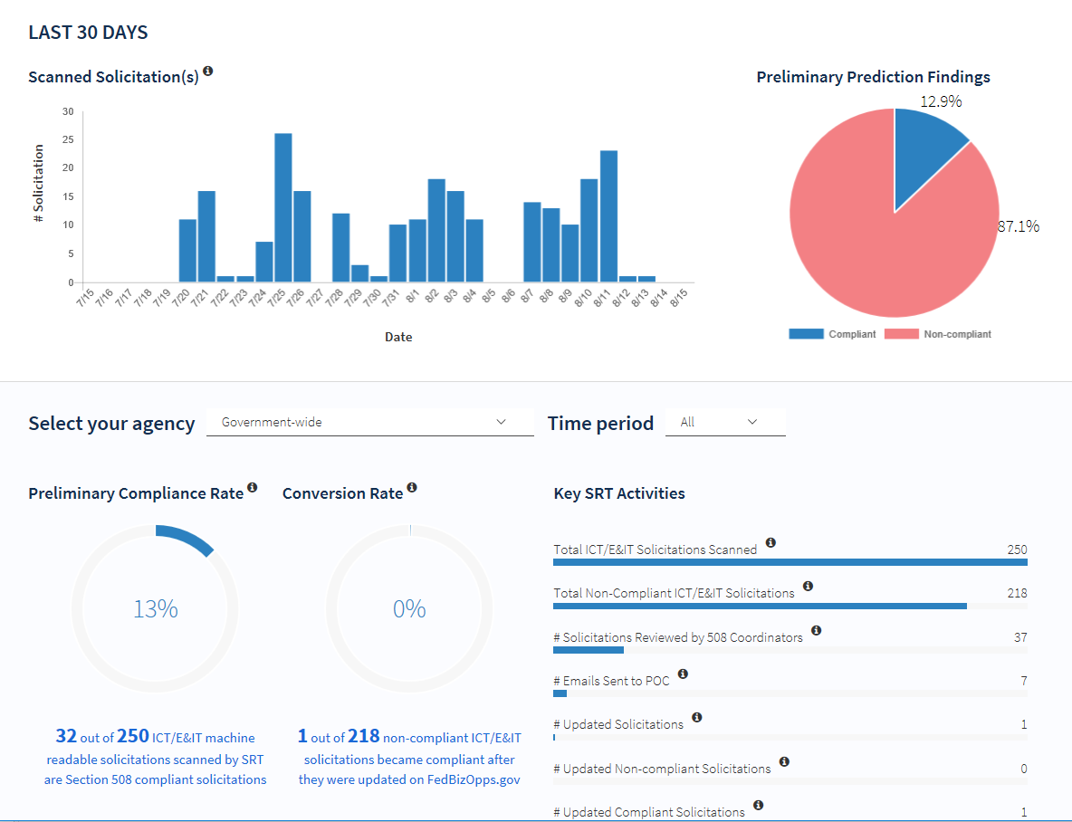
Analytics Module
View the total number of scanned ICT / E&IT solicitations and preliminary predictions of non-compliance.
Track the activities undertaken to convert non-compliant solicitations into compliant ones.

Slide 44
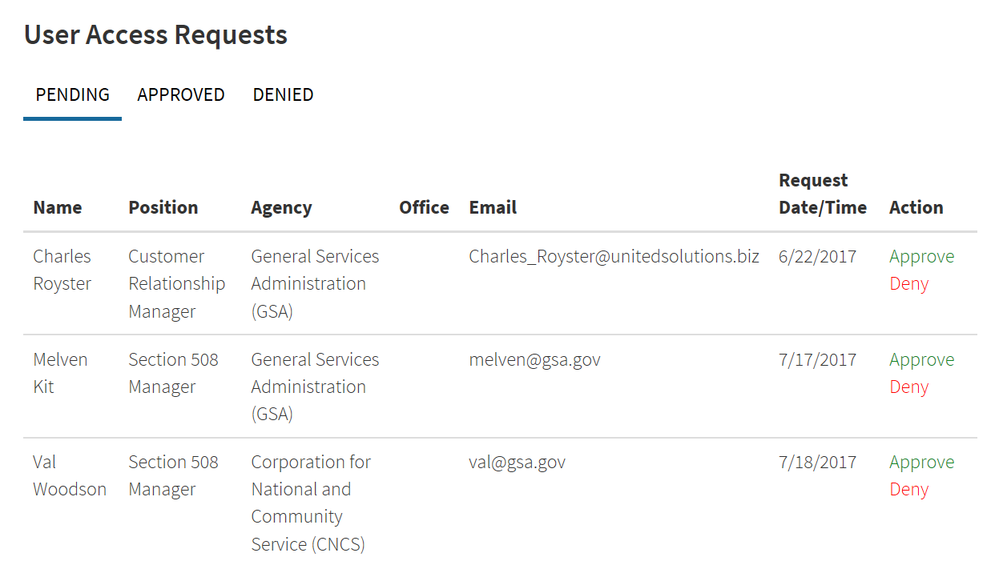
Manage Access Requests
System Administrator reviews pending access requests.
System Administrator is empowered to approve or reject pending access requests.

Slide 45
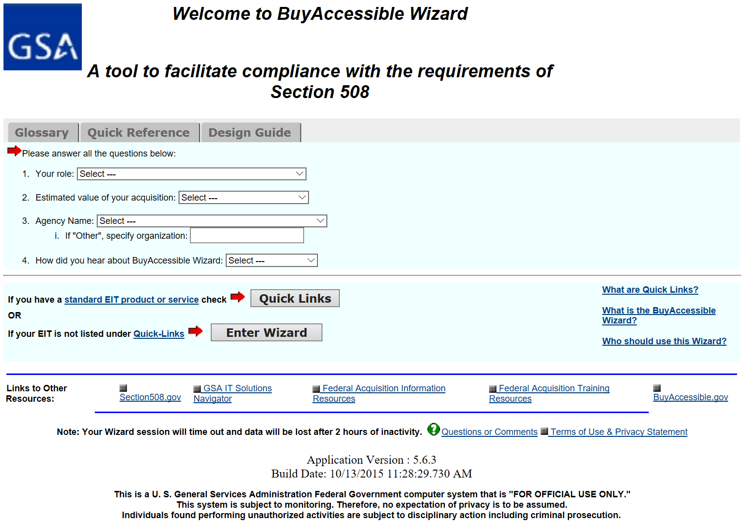
Get Additional Resources
Users have access to additional resources from complementary systems such as the BuyAccessible Tool.

Slide 46
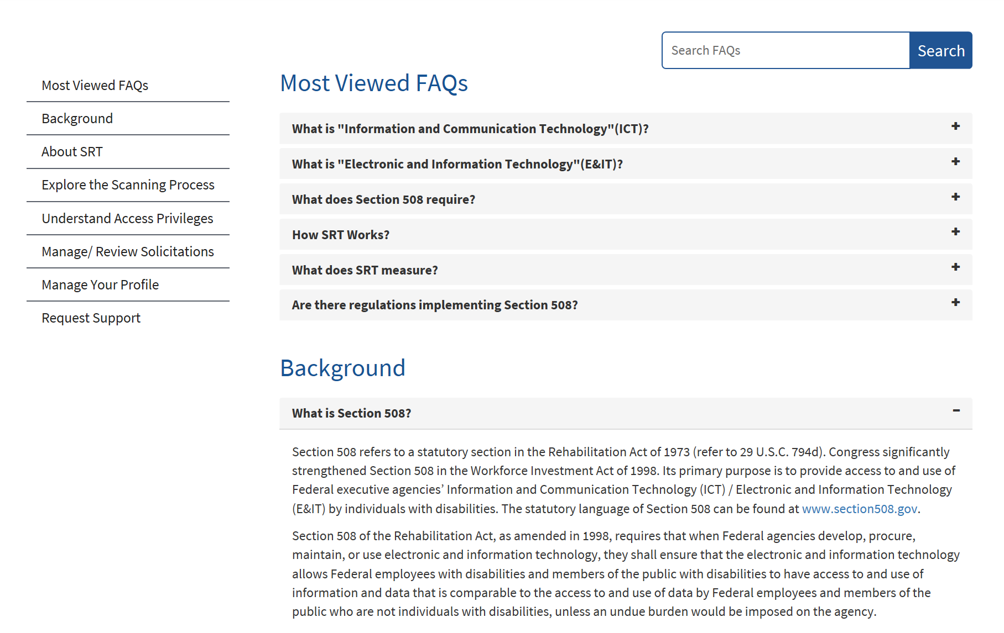
FAQ
Users have access to Frequently Asked Questions (FAQ) carefully organized and searchable by keyword.
FAQs are strategically linked to different parts of the system.

Slide 47


US NAVY – Military Sealift Command
Machine Learning to Improve
Reliability Centered Maintenance (RCM) Analysis
Notes:
Is Title good?

Slide 48

Strategic Goal
Preventive, condition monitoring based maintenance
Proactive, reliability based maintenance
Notes:
Long term goal of where we want to be. Etc.
How what we are doing is going to contribute to long term.

Slide 49

Background
Military Sealift Command
Division of US Navy: Own and operate over 100 ships
MSC Engineering N7 exercises Technical Authority over maintenance and repair decisions for the fleet.
Notes:
Quick Background on MSC and MSC Engineering
Smaller Govt organization so efficiency is important for us.

Slide 50

Problem
800,000+ maintenance documents in unstructured format with valuable information
Notes:
800,000+ maintenance documents in unstructured format across the fleet with valuable information to support maintenance decision making.
Need to extract the information and combine it with other meta data in the MSC Maintenance Management database so efficient analysis could be done

Slide 51


Task
Need to extract the information
Combine it with other meta data in the MSC Maintenance Management database
So efficient analysis could be performed
Notes:
AI solutions works hand in hand with your proceses in place.
Huge amount of data, we want to reduce it to the important data that we need to focus our efforts on.
Can we also discuss where AI can be used in other aspects? VRR – work item comparison, Failure mode. Etc.

Slide 52
Why AI?
Human enhanced AI review
Manual review
Scalable
Long term
Automated
Notes:
Options were to have manual engineers go thru these documents.

Slide 53
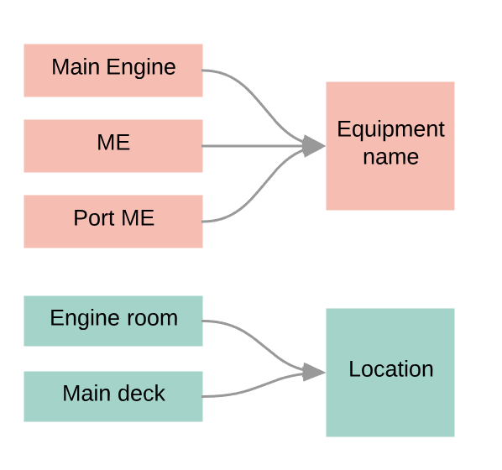
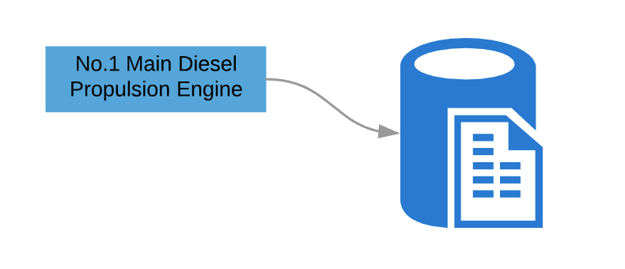
Solution
Step 1
Step 2
Annotate documents on sample set of 600 documents
Train and build model to identify key entities
Map entities to fields in Database using Text classification
Compared CNN, RNN, Siamese, SVM and other neural network models
Built UI for SME’s to verify
3000+ eq. for a single ship
Notes:
CNN – Convolution NN - 10 -20 different models
RNN - Recurrent Neural Network
Siamese: Pretty good to identify but takes a long time
SVM:
RNN & Siamese have good advantage, but CNN works better for us.
Different implementations to see which one fit
HSC we ended up with CNN
# of eq. use CNN + Sentence embedding from Google.
Normal compare a sentence or phrase, you use RNN.
Sentence embedding from Google (better than RNN).
With MSC,

Slide 54

Technologies
IBM Watson
Google TensorFlow
Scikit
IBM Watson
Keras
Notes:
Keras for CNN
Scikit for word embedding, tokenizer.

Slide 55
Result
Cost Savings from manual extraction of information
Visibility into full equipment and maintenance history for more focused maintenance analysis
Notes:
If we can come up with a high level ROI, that would be great.
Also, can we discuss VRR to work item spec comparison as well.

Slide 56
Lessons Learnt
Involve & Provide SME’s with basic training on understanding AI and the expected outcome
Provide SME’s guidelines and approach to annotation of documents to ensure consistency
Integrate with existing systems so that the learning and benefits are continous
Notes:
This is a continuous process and not a one time development like your traditional software development.
SME’s are critical to train the system. The better the training the better the results.
Even if SMEs leave, AI model can continue to work
Enables them to spend more time collaborating vice analyzing the data

Slide 57
What's next
Expand this to other maintenance documents
Predicting need for parts based on Failure modes
and more...

Slide 58

THANK YOU
william.s.carroll@navy.mil
mallesh.murugesan@abeyon.com

Slide 59
Strategic Goal
Move from a preventive, condition monitoring based maintenance approach to a proactive, reliability-based maintenance approach that uses data analysis in support of maintenance decision making
Notes:
Long term goal of where we want to be. Etc.
How what we are doing is going to contribute to long term.

